Slide 1
Python
High Level Programming Language

Slide 2
What is Python?
a simple, general purpose, high level, and object-oriented programming language.
an interpreted scripting language also.
Guido Van Rossum is known as the founder of Python programming (1989) .
The following programming languages influence Python:
ABC Language
Modula 3

Slide 3
Why learn Python?
Easy to use and Learn
Expressive Language
Interpreted Language
Object-Oriented Language
Open Source Language
Extensible
Learn Standard Library
GUI Programming Support
Integrated
Embeddable
Dynamic Memory Allocation
Wide Range of Libraries and Framework

Slide 4
Where is Python used?
Data Science
Data Mining
Desktop Applications
Console-based Applications
Mobile Applications
Software Development
Artificial Intelligence
Web Applications
Enterprise Applications
3D CAD Applications
Machine Learning
Computer Vision or Image Processing Applications.
Speech Recognitions

Slide 5
Python Popular Frameworks and Libraries
Web development (Server-side) - Django, Flask, Pyramid, CherryPy
GUIs based applications - Kivy, Tk, PyGTK, PyQt, PyJs, etc.
Machine Learning - TensorFlow, PyTorch, Scikit-learn, Matplotlib, Scipy, nltk etc.
Mathematics - Numpy, Pandas, etc.

Slide 6
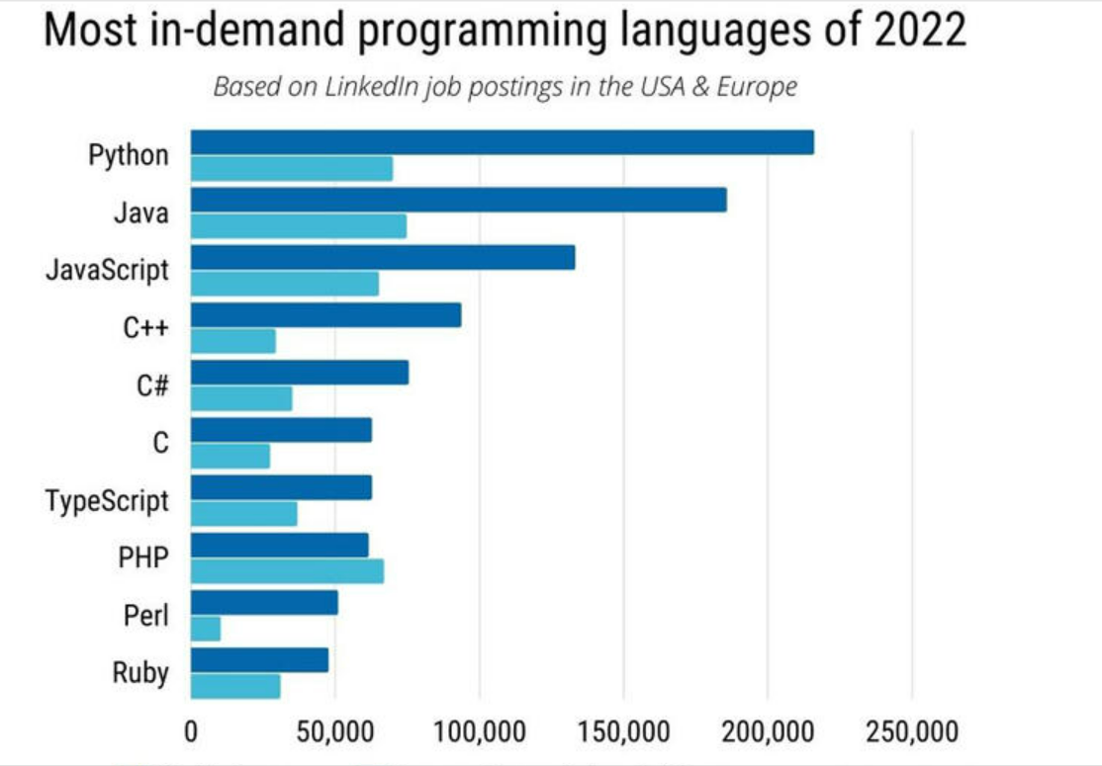

Slide 7
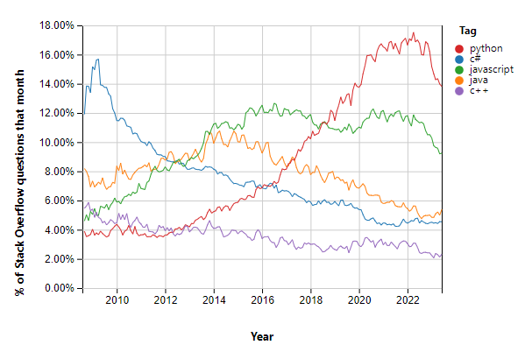

Slide 8
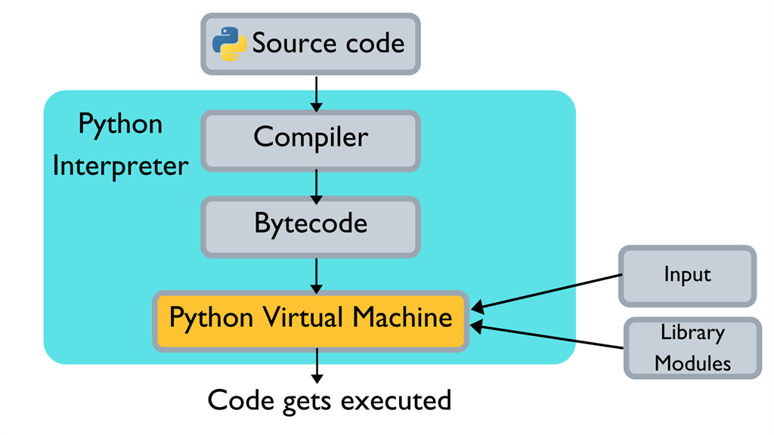
Execution of a program in Python

Slide 9


